Slide 1
ML algorithms

Slide 2
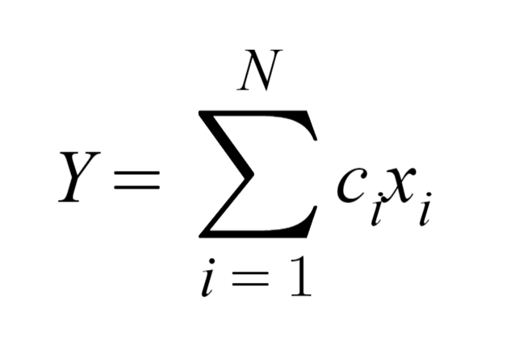
Linear regression
Least squares is most common method (fast) to calculate coefficients
Model between explanatory and observed variable
Measure of association between the two is correlation coefficient
Sensitive to changes in data due to outliers

Slide 3

Random forest
Does multiclass classification
Done by creating multiple binary problems
Works on mixture of numerical and categorical features
Calculates the probability of the inputs being in a certain class
Can do regression by taking the mean of individual trees

